Slide 1
Endterm
Project
Authors: Pernebayev Sanzhar, Shuishabaev Nuruddin
Title: CRM and DB analysis
Course: OOP Java
Group: CS-2009
Instructor: Dostiyarov Adilbek

Slide 2
01
02
03
04
05
06
OUR
TEAM
ABOUT THE PROJECT
About the authors of the endterm project
Platforms and programs that we used
MAIN REQUIREMENTS
Important project requirements
PROJECT GOALS
Analyze customer database
PROJECT STAGES
the project in detail
From architecture design to testing
Demonstrate the code in more detail

Slide 3
OUR TEAM
Pernebayev
Sanzhar
Shuishbaev
Nuruddin
Support for the creation of the project architecture, creation of the main diagram, filling in data in the database, partial creation of methods for outputting data in a JVM, testing the project.
Partial creation of the project architecture, support for the creation analyzed methods in the JVM, filling in data in the database, working with documentation, testing the project.

Slide 4
ABOUT THE PROJECT
Our project was designed to analyze customer relationship management data(CRM). We took the client database and enter it into PGadmin and output the data using a java virtual machine. In the project, we used several classes, methods to get the analyzed data.

Slide 5
What we worked on
pgadmin 4
Intellij idea
is the leading Open Source management tool for Postgres, the world's most advanced Open Source database.
An integrated software development environment for many programming languages, in particular Java.
app.diagrams.net
is free online diagram software for making flowcharts, process diagrams, org charts, UML, ER, and network diagrams.

Slide 6
MAIN REQUIREMENTS
01
02
03
A group should consist 1-2 students
Project must consist of all topics that we studied
Your project should not be so simple. it should consist of more than 3-4 classes
04
05
06
Use the capabilities of OOP: classes, inheritance, polymorphism etc.
Use external data sources: DBMS
Use Exception handling

Slide 7
PROJECT GOALS
We can analyze the data and get different sorted data; and enter some data into the database via JVM.
The program that allows you to display the various analyses of data from the database, for example, show the cheapest products, sort the social status of customers by groups, etc.

Slide 8
PROJECT STAGES
STAGE 1 Brainstorming
Creating and designing the architecture of the project
STAGE 2 Realization
Creating a data table in pgAdmin and replenishing a data
STAGE 3 Getting results
Coding in JVM and checking OOP Style testing the program

Slide 9
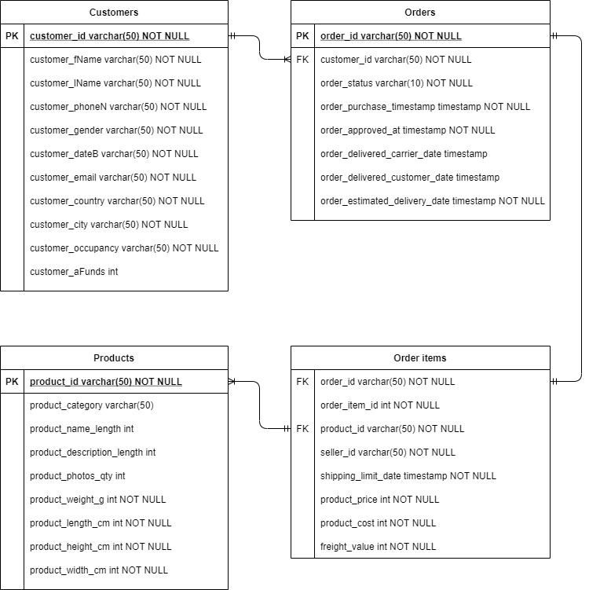

PROJECT Architecture: ERD of DB
ER Diagram consists of 4 entities

Slide 10
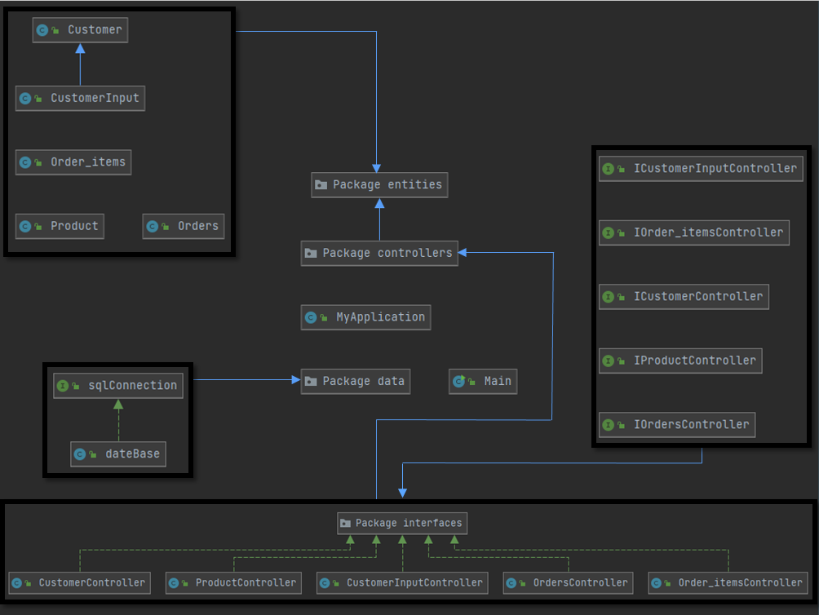
PROJECT Architecture: JAVA UML
Packages:
Entities: 5 classes
Controllers: 5 classes
Data: 1 class

Slide 11
the project in detail

Slide 12
THANKS
Does anyone have any questions?
Sanzhar Pernebayev
202140@astanait.edu.kz
Nuruddin Shuishabev
202017@astanait.edu.kz

